Slide 1
Project Capstone – Final Assignment
Data Scientist @ Central Park Hotel New York

Slide 2
Data Scientist Main Goal
Find out the total number of malls present around Park Central Hotel, New York.
Within 1 KM radius of hotel.
Additional information regarding identified malls.

Slide 3



Data Acquisition & Sources
Google
Foursquare (API)
Python

Slide 4
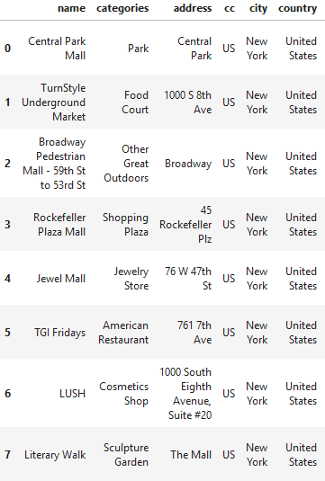
Results
Tabular format from Pandas Dataframe
Shows 8 hotels within 1 KM radius of hotel
Full address of each malls
Categories of what each malls offers

Slide 5
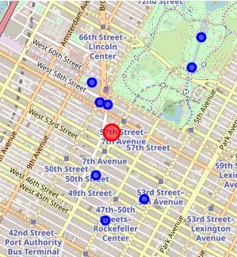
Map Visualization
Red dot represent Park Central Hotel
Blue dots represent Malls (Within 1KM radius of hotel)
Total = 8 malls

Slide 6
Conclusion & Future Consideration
Total of 8 malls identified within 1 KM of Park Central Hotel
Captures the exact address and locations of malls near the hotel
More data can be obtained via Foursquare by upgrading account

